Slide 1
Server-Side Request Forgery (SSRF)
Logan Therrien
13 February 2023

Slide 2
Objectives
Understand OWASP Top 10
Understand a SSRF – Server-Side Request Forgery
Describe Recent SSRF Attacks
Describe Types of known SSRF Vulnerabilities
Describe how to prevent SSRF Attacks

Slide 3
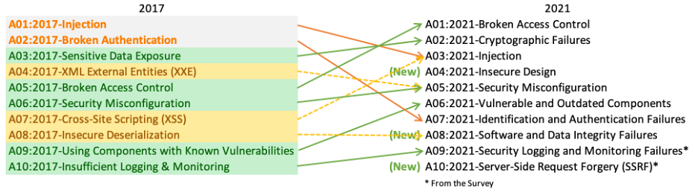
OWASP TOP 10
https://owasp.org/Top10/

Slide 4
Notable Breaches
Capitol One (2019)
https://krebsonsecurity.com/2019/08/what-we-can-learn-from-the-capital-one-hack/
https://www.capitalone.com/digital/facts2019/
Microsoft Exchange Server (2021)
https://www.zdnet.com/article/everything-you-need-to-know-about-microsoft-exchange-server-hack/
https://www.microsoft.com/en-us/security/blog/2021/03/02/hafnium-targeting-exchange-servers/
Attacker: China State sponsored group, Hafnium

Slide 5
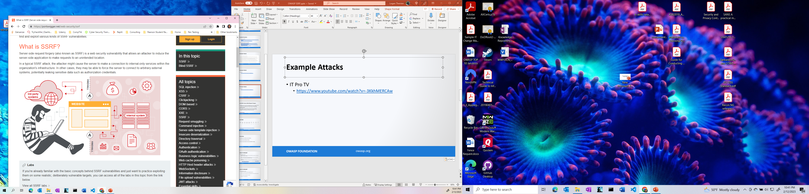
Example Attacks
Portswigger.net

Slide 6
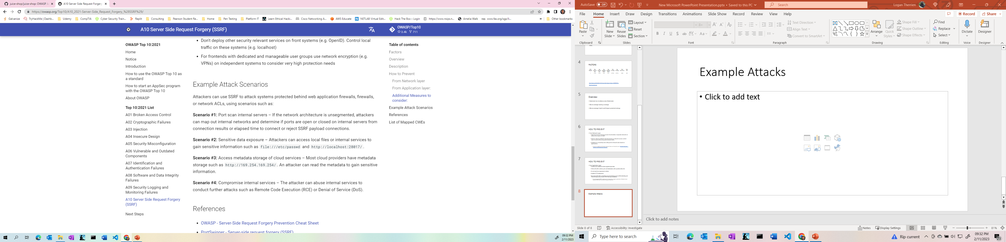
Example Attacks

Slide 7
Example Attacks
IT Pro TV
https://www.youtube.com/watch?v=-pNYmgK_dWo

Slide 8
A10:2021 Server-Side Request Forgery
Added from the Top 10 community survey (#1). The data shows a relatively low incidence rate with above average testing coverage, along with above-average ratings for Exploit and Impact potential.
This category represents the scenario where the security community members are telling us this is important, even though it's not illustrated in the data at this time.
https://owasp.org/Top10/

Slide 9
FACTORS
CWEs Mapped | Max Incidence Rate | Avg Incidence Rate | Avg Weighted Exploit | Avg Weighted Impact | Max Coverage | Avg Coverage | Total Occurrences | Total CVEs
1 | 2.72% | 2.72% | 8.28 | 6.72 | 67.72% | 67.72% | 9,503 | 385
https://owasp.org/Top10/A10_2021-Server-Side_Request_Forgery_%28SSRF%29/
https://cve.mitre.org/

Slide 10
Overview
Relatively low incidence rate (relative)
Above average testing coverage
Above-average Exploit and Impact potential ratings

Slide 11
HOW TO PREVENT
From Network Layer
Segment remote resource access functionality in separate networks to reduce the impact of SSRF
Enforce “deny by default” firewall policies or network access control rules to block all but essential intranet traffic.
Establish an ownership and a lifecycle for firewall rules based on applications.
Log all accepted and blocked network flows on firewalls (see A09:2021-Security Logging and Monitoring Failures).

Slide 12
HOW TO PREVENT
From Application Layer
Sanitize and validate all client-supplied input data
Enforce the URL schema, port, and destination with a positive allow list
Do not send raw responses to clients
Disable HTTP redirections

Slide 13
References
OWASP - Server-Side Request Forgery Prevention Cheat Sheet
PortSwigger - Server-side request forgery (SSRF)
Acunetix - What is Server-Side Request Forgery (SSRF)?
SSRF bible
A New Era of SSRF - Exploiting URL Parser in Trending Programming Languages!

Slide 14
QUESTIONS

